Slide 1
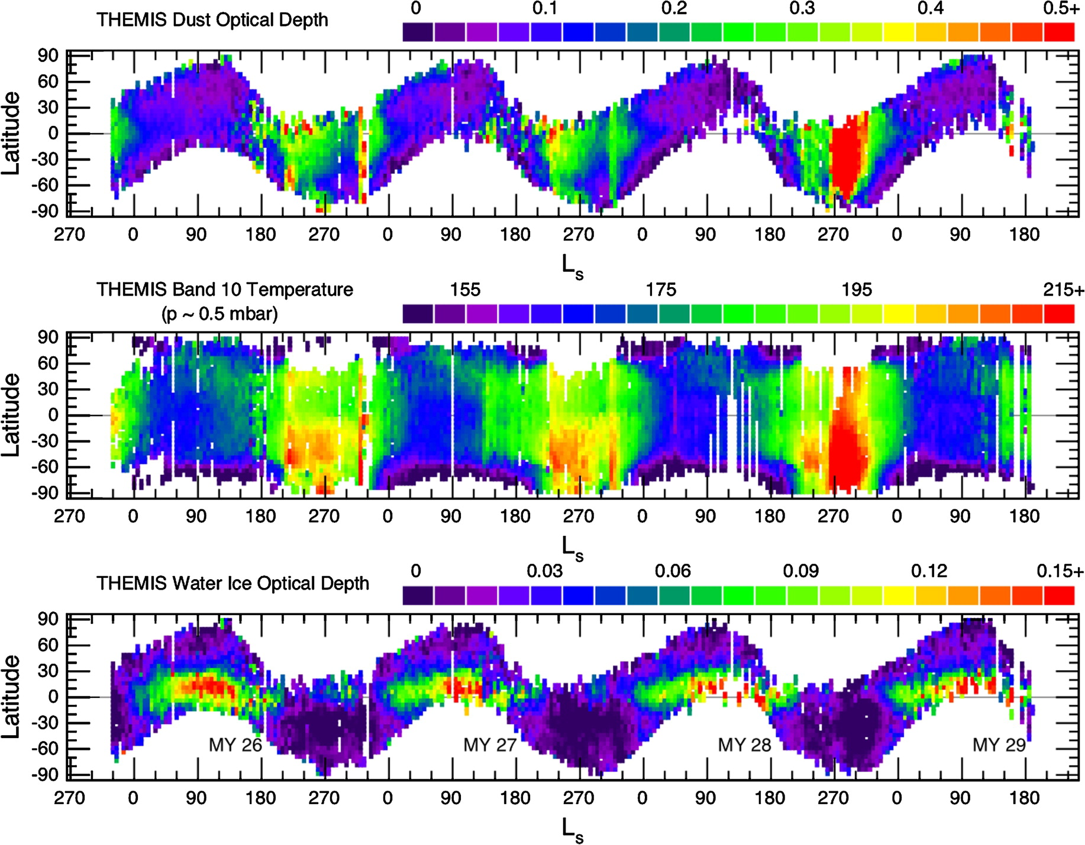
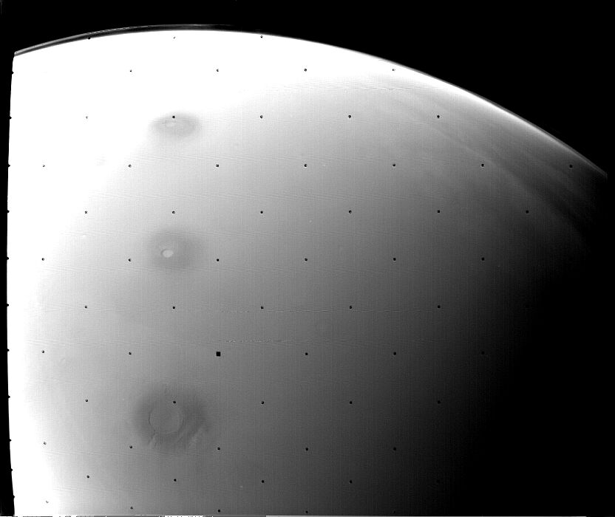
P21A-1646
Effects of Dust Storms in the Upper Atmosphere of Mars
Robert Pratt and Paul Withers
Center for Space Physics, Boston University, Boston, MA 02215
Abstract
Dust storms are well known to strongly perturb the state of the lower atmosphere of Mars, yet few studies have investigated their impact on the upper atmosphere. Mars Global Surveyor aerobraking accelerometer density measurements revealed that regional dust storms can cause significant changes in atmospheric density as high as 130-160 km, even thousands of kilometers away from the location of the dust storm itself. Mars Express SPICAM UV spectrometer measurements during stellar occultations have also shown that atmospheric density increases during a dust storm in the middle atmosphere, 70-130 km. Here we report the results of an investigation into the effects of dust storms on the upper atmosphere using observations from aerobraking orbiters and SPICAM. We investigate how the fractional increase in atmospheric density during a dust storm depends on altitude and on distance from dust storm center. We also quantify the timescales over which densities increase at dust storm onset and decay afterwards. These results will be useful for characterizing coupling between atmospheric regions during the extreme conditions presented by a raging dust storm and can be contrasted with the coupling present during quiescent conditions. They will also be useful for planning operations of deep-dipping orbiters, such as MAVEN.
Dust storms can have substantial effects on the upper atmospheric conditions in which MAVEN will operate. Densities can double or more over only a few days, even far away from the center of a storm. For substantial storms, these effects can persist for a month or longer. We recommend that MAVEN develop procedures for responding to the onset of a dust storm and explore what assets can provide early warning of dust storms.
Hantsch et al. (1990)
Smith et al. (2000)
Smith et al. (2000)
Smith et al. (2009)
(1)
A regional dust storm centered on the Noachis Terra region (approximately 40ºS, 0ºE) occurred during MGS aerobraking. This caused a sharp increase, followed by a steady decline, in upper atmospheric densities measured by the MGS accelerometer far in the northern hemisphere. The timescale for decay in thermospheric densities was 40 – 80 degrees of Ls (80 – 160 sols). This timescale does not depend on altitude between 130 km and 160 km, but it does decrease with increasing distance from the dust storm. This is contrary to the trend seen in lower atmospheric observations. The peak thermospheric density enhancement is a factor of two at all altitudes and latitudes sampled.
A relatively small dust storm occurred at Ls = 130º in Mars Year 27 (yellow box in lower plot). This caused the altitude of peak ionospheric electron density, which corresponds to a constant pressure level, to rise then fall. This was detected by MGS radio occultation measurements.
Mariner 9 reached Mars in 1971 during a massive dust storm that obscured almost the entire surface. The ionospheric peak was elevated by 20-30 km above its typical altitude due to the extreme expansion of the lower atmosphere. Its radio occultation measurements reveal the steady decay of peak altitude towards typical values. The orbital period was 12 hours, or about 1/4 degrees of Ls. The timescale is roughly comparable to those determined for the Noachis dust storm from MGS accelerometer data.
References
Smith, M. D., J. C. Pearl, B. J. Conrath, and P. R. Christensen (2000), Mars Global Surveyor Thermal Emission Spectrometer (TES) observations of dust opacity during aerobraking and science phasing, J. Geophys. Res., 105, 9539-9552
Smith, M. D. (2009), THEMIS observations of Mars aerosol optical depth from 2002-2008, Icarus, 202, 444 – 452
Hantsch, M.H., Bauer, S.J. Solar control of the Mars ionosphere. Planet. Space Sci. 38, 539–542, 1990.
and
(1) http://blogs.agu.org/martianchronicles/2008/05/22/the-search- for-life-on-mars-part-2/

