Slide 1
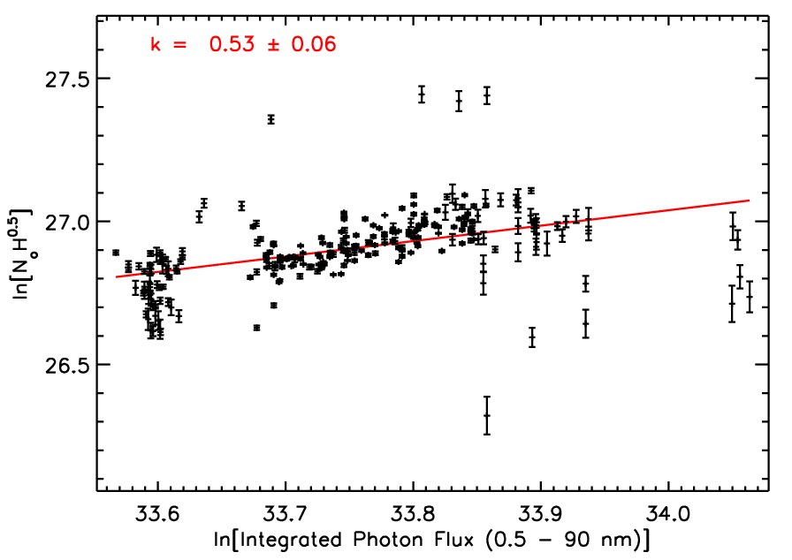
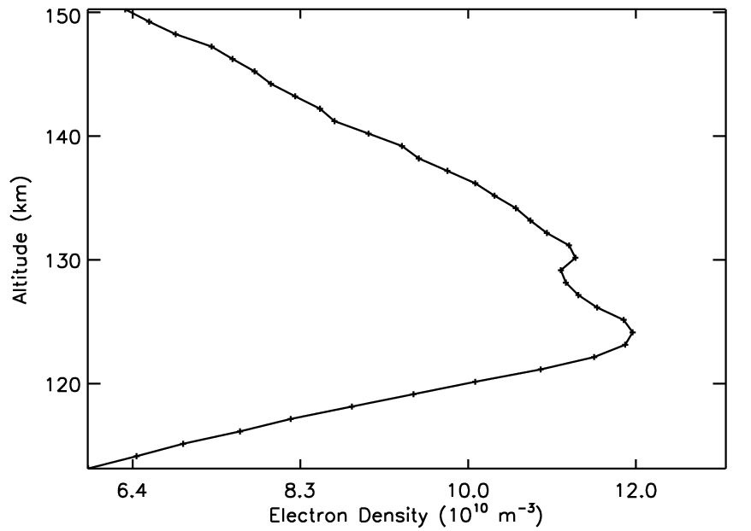
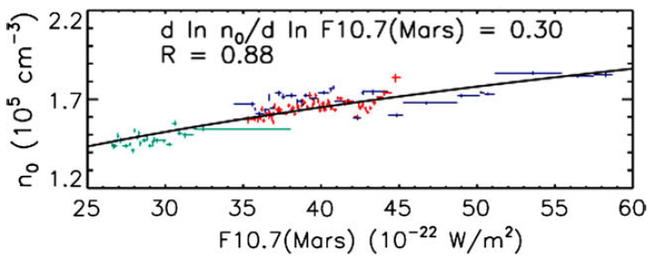
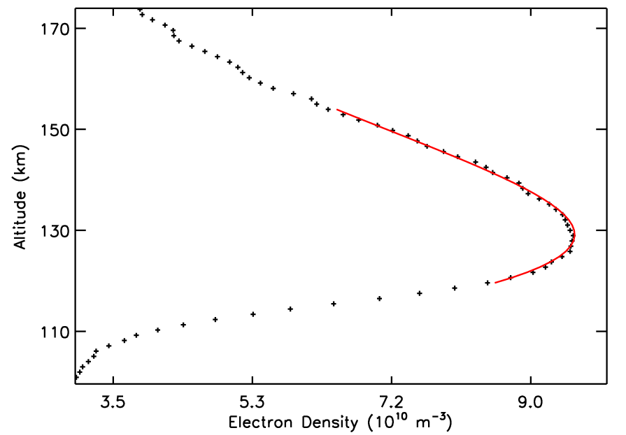
How Chapmanlike is the Ionosphere of Mars?
SA13A-1879
Zachary Girazian¹ (zrjg@bu.edu), Paul Withers¹, Kathryn Fallows¹, Martin Paetzold², Silvia Tellmann²
¹Boston University, ²University of Cologne
INTRODUCTION
METHOD
UNUSUAL MORPHOLOGIES
The dominant ionospheric layer at Mars, the M2 layer, is produced by photoionization of CO₂. Photons with energies greater than the ionization potential of CO₂, corresponding to wavelengths less than 90 nm, penetrate the atmosphere and produce at least one ion-electron pair upon absorption.
Chapman theory (Chapman 1931) predicts how the maximum electron density depends on the ionizing photon flux.
(1)
where N_{o} is the subsolar maximum electron density, F is the ionizing photon flux, α is the recombination coefficient, e = 2.7182, and H is the neutral scale height.
Although Chapman theory has many idealized assumptions, N_{o} ∝ F^{0.5} should be satisfied by any photochemically controlled ionosphere whose dominant ion loss mechanism is dissociative recombination (Withers 2009).
To investigate if the F_{10.7} and E_{10.7} solar proxies are inadequate, we use the integrated photon flux from 0.5 – 90 nm for F in Eq. 1. The photon fluxes were measured by the Solar Extreme Ultraviolet Experiment (SEE) on the TIMED spacecraft. The best-fit exponent using Mars Express (MEX) radio occultation data with SZA < 80º is shown below.
The best-fit value is k = 0.53, much closer to the expected k = 0.5. However, the value changes when Mars Global Surveyor data or different time-spans are used. In addition, interpreting the exponent is difficult; it is unknown how the neutral scale height and the recombination coefficient depend on the ionizing flux. We are currently working on the physical interpretation of these findings.
Unusual features are seen in many electron density profiles from MEX radio occultation data. The figures below show two recurrent features in the M2 layer.
A small number of profiles have an elongated, flat peak. The value of the peak electron density is comparable to peak electron densities of profiles that are Chapman-like and have similar solar zenith angles.
PREVIOUS FINDINGS
Many previous investigators have used the F_{10.7} and E_{10.7} solar proxies for F in Eq. 1, and assumed a constant α. The best-fit exponent, k, is measured using
The best-fit exponents have varied widely, with k ≈ 0.35, much less than the expected k = 0.5. The reason for non-Chapman k values is either the solar flux dependence of N_{o} is not described well by Chapman theory, or the F_{10.7} and E_{10.7} proxies are an inadequate description of the ionizing solar flux at Mars.
MORPHOLOGY OF THE M2 LAYER
The morphology of the M2 layer agrees well with Chapman theory in many electron density profiles. Shown below is an example of a Chapmanlike profile.
Wave-like structures near the peak of the ionosphere are the most common unusual feature seen in the MEX data set. The width of these profiles are Chapman-like.
REFERENCES
The best-fit exponent, k = 0.30, as measured by Morgan et al. 2008 using Mars Express radar sounding data. The exponent is similar to those derived by other investigators.
Chapman, S. 1931. The absorption and dissociative or ionizing effect of monochromatic radiation in an atmosphere on a rotating earth. Proc. Phys. Soc. 43 26.
Morgan, D.D., et al. 2008 Variation of the Martian ionospheric electron density from Mars Express radar soundings. J. Geophys. Res. 113, A09303
Withers, P. 2009. A review of observed variability in the dayside ionosphere of Mars. Adv. Space Res , 44s, 277-307.

