Slide 1
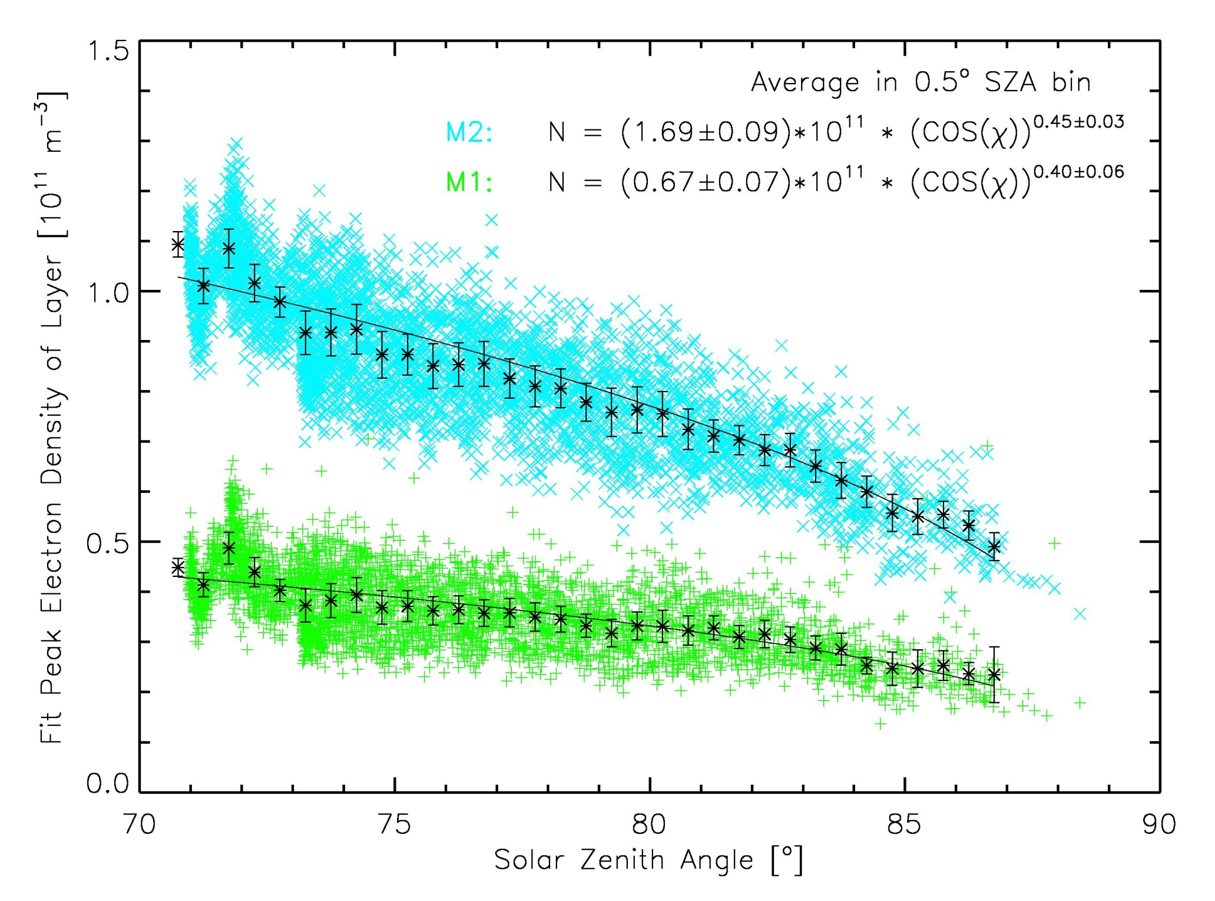
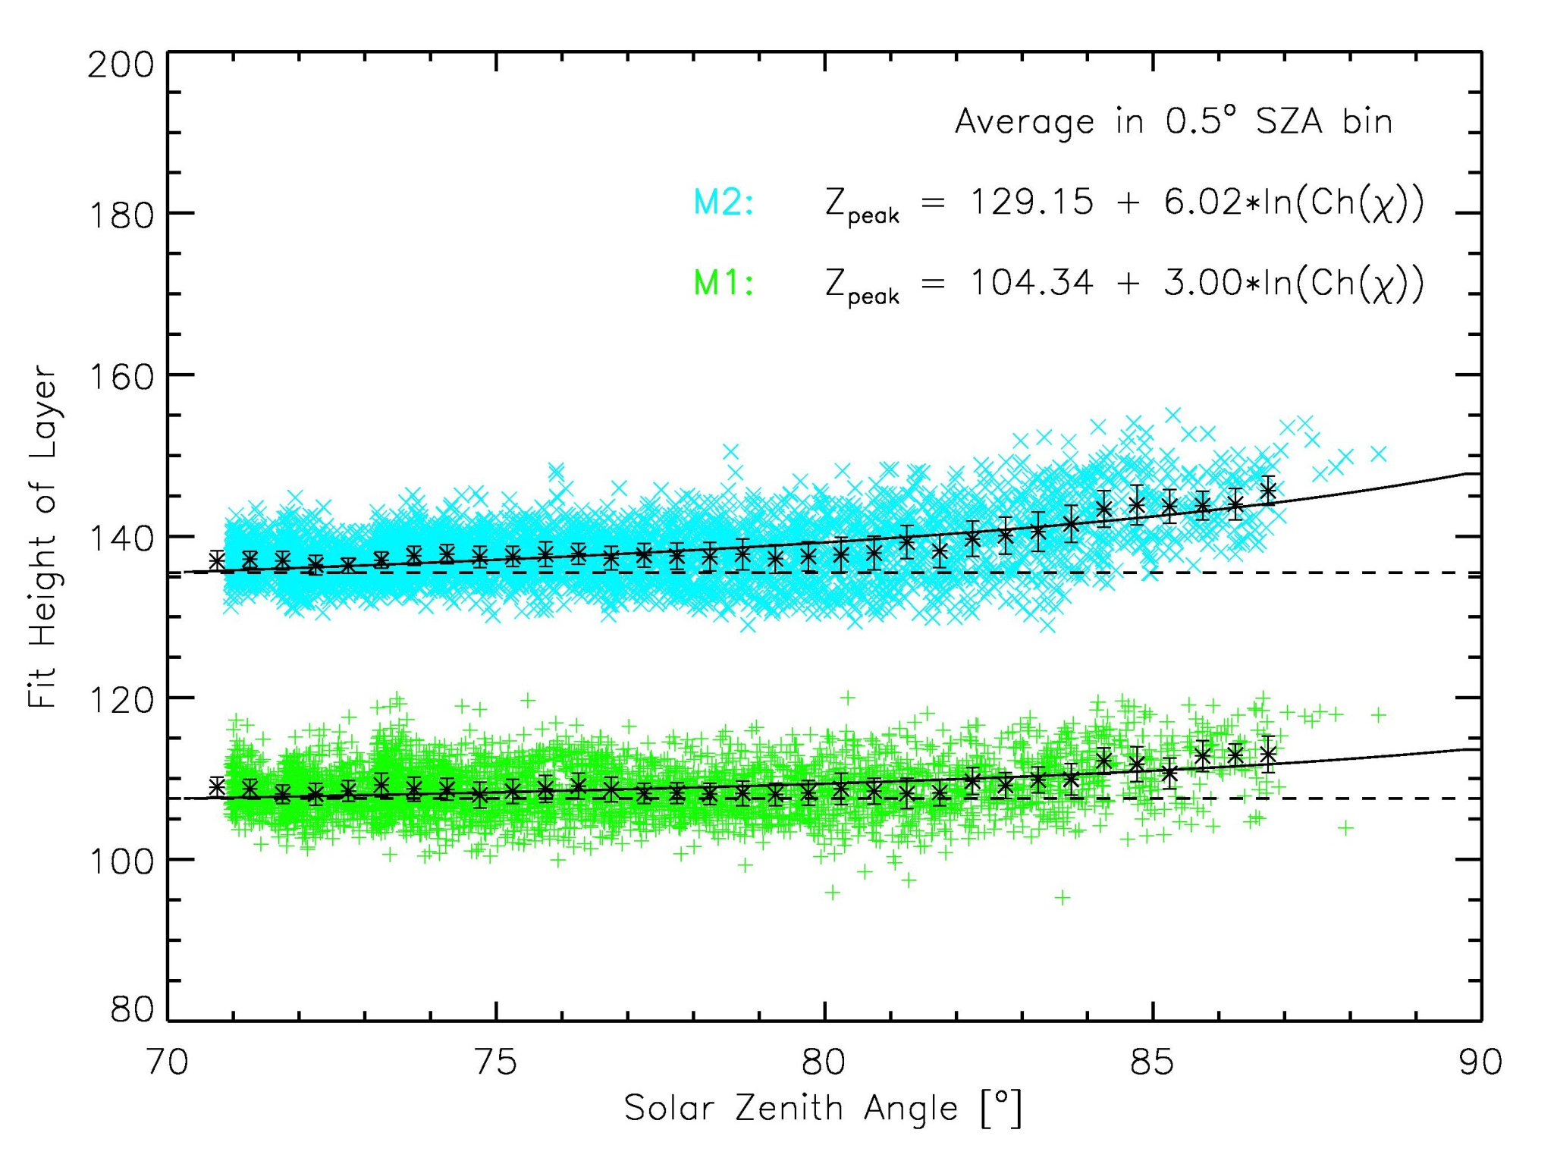
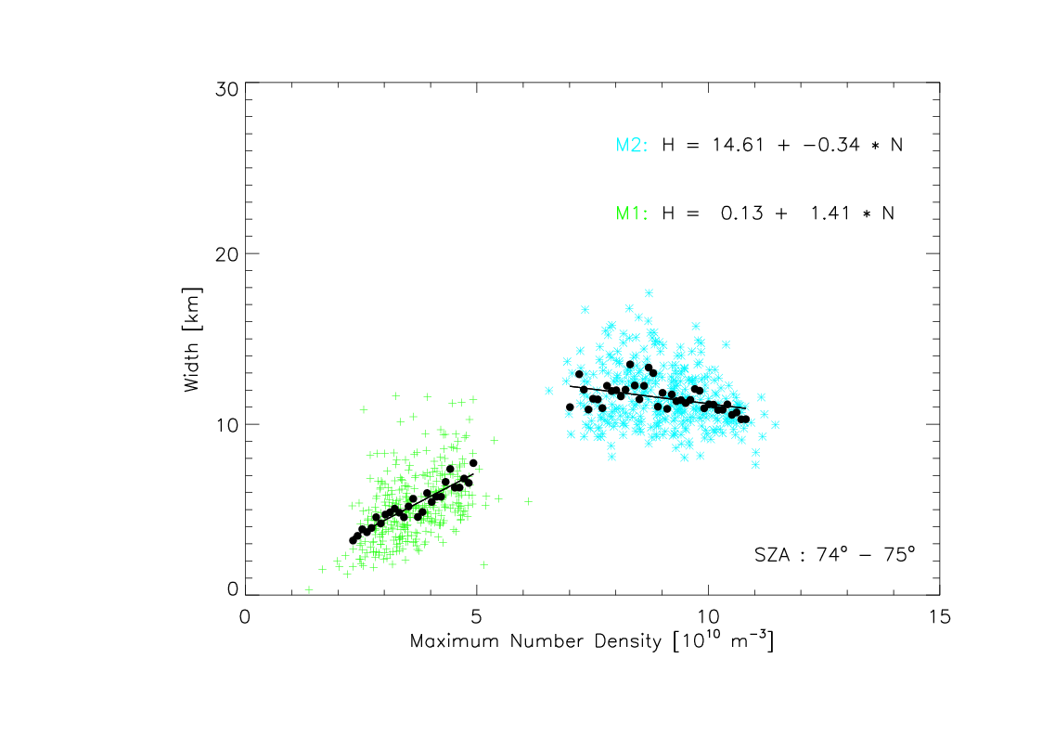
Variability in the M1 Layer of the Martian Ionosphere
SA13A-1880
Kathryn Fallows (kfallows@bu.edu), Paul Withers, Zachary Girazian
Boston University, Center for Space Physics
Abstract:
A simple representative model of the ionosphere of Mars is fit to the complete set of electron density profiles from the Mars Global Surveyor radio occultation experiment database. Both the primary (M2) and secondary (M1) peaks in electron density are represented as the sum of two Chapman layers. While this model is not intended to reflect the physical processes present at all altitudes, it proves to be a useful method to determine several characteristics of the electron density profile, including the width, height, and maximum electron density of each layer. Here we report an analysis of these derived characteristics for the M1 layer. While the altitude of the M2 layer is known to increase with increasing solar zenith angle (SZA), the altitude of the M1 layer does not change significantly with SZA. The peak electron density of the M1 layer is observed to increase with decreasing SZA. The M1 layer appears to increase in width as its peak electron density increases, though the opposite trend is observed in the M2 layer.
Fitting Procedure
Results
We fit the function described in the Fitting Procedure panel to 5600 electron density profiles from the Mars Global Surveyor’s Radio Science experiment. Of these, about 4000 were fit well. The parameters are studied to look for trends in variability. Below are a few examples of the possible relationships that can be explored.
M2
M1
An electron density profile measured by the Mars Global Surveyor (MGS) Radio Science experiment is shown in black. A peak in the electron density regularly occurs at about 130-140 km above the surface. This is labeled the M2 layer of the ionosphere. A smaller, more variable peak in electron density, the M1 layer, often occurs at about 110-115 km. The M2 layer is formed by photoionization due to incident extreme ultraviolet solar flux. The M2 layer is formed primarily by electron impact ionization due to X-ray solar flux.
The red line is a fit to the electron density and is described below.
A. The change in the peak electron density of the M2 (blue) and M1 (green) peaks with solar zenith angle (SZA). Black points are averages in 0.5 degree SZA bins. The equation fit to the M2 averages is the expected trend from Chapman theory:
B. The change in the altitude of the peak number density of the M2 (blue) and M1 (green) layers with solar zenith angle. Black points are averages in 0.5 degree SZA bins. The equation fit to the M2 averages is the expected trend from Chapman theory:
A and B: The Chapman equations can be fit to the M1 measurements, but straight lines fit almost as well. It is not necessarily expected that the Chapman relationships should fit the M1 layer, since they do not include the process of electron impact ionization, which is significant in the M1 region. However, in both cases, the trends exhibited by the two layers are quite similar, though more pronounced in the M2 layer.
C
$N=N_{2}exp⁡[0.5(1−\frac{z−z_{2}}{H_{2}}−\exp\left(\frac{z−z_{2}}{H_{2}}\right)]$ + $N_{1}exp⁡[0.5(1−\frac{z−z_{1}}{H_{1}}−\exp\left(\frac{z−z_{1}}{H_{1}}\right)]$
$$N_{m}={N_{0}}/{\sqrt{Ch(χ)}}$$
The above function, based on Chapman theory, describes two peaks in electron density in the ionosphere. The parameters of the fit are the peak number density, ($N_{2}$, $N_{1}$), the altitude of the peak, ($z_{2}$, $z_{1}$), and the scale height, ($H_{2}$, $H_{1}$). This function can be fit to large sets of electron density profiles as a way to systematically measure important quantities about the profile, which can then be considered across a large data set. This has been especially difficult to do for the M1 layer, which often as a bump or shoulder in the profiles, rather than a local maximum in electron density.
A caveat: The physics included in Chapman theory are valid only at the M2 layer. We can use this equation to measure important aspects of the profile, but must be careful about connecting them to the physical properties of the ionosphere.
$$z_{m}=z_{0}+H\ln{Ch(χ)}$$
C. The relationship between the width of the layer, (the fit parameter H), and the peak number density for the M2 (blue) and M1 (green) layers. The black points are averages in bins of 1x10⁹ m⁻³. Data are shown only from profiles collected at a SZA of 74-75 degrees to minimize SZA effects. The two layers appear to behave very differently. The with of the M2 layer appears to decrease slightly as the number density increase, while the width of the M1 layer appears to grow quickly as the number density increases.

